Slide 1
Interpolative Shading
CS 460: COMPUTER GRAPHICS

Slide 2
Interpolative shading
Remember that most graphics hardware can only draw polygons.
Smooth curved surface has to be polygonized in order to be displayed.
If you shade each surface honestly using previously mentioned Phong illumination model, you will see ….
The surface is not smooth when display.

Slide 3
Interpolative Shading
Smooth surfaces are often approximated by polygonal facets because:
  Graphic hardware generally wants polygons
  We know how to intersect rays with polygons
How do we compute the shading for such a surface?
  Interpolative shading

Slide 4
Interpolative shading
To recover (approximately) the visual appearance of curved surface which is now represented by flat polygons.
Assumptions:
1) An approximate normal (vertex normal) at each vertex can be computed by averaging the normals of the polygons sharing that vertex.
2) The shading of a particular pixel can be obtained by a bilinear interpolation of the appropriate quantities from adjacent vertices.
N_{p}=(N₁+N₂+N₃+N₄) / 4

Slide 5
1. Goraud shading
Calculate the intensity at each vertex using local reflection model
Intensities of interior pixels are determined by bilinearly interpolating the vertices’ intensities (remember the rasterization lecture)
Interpolation equations are:
I_{a} = [ I₁ ( y_{a}- y₂ ) + I₂ ( y₁ – y_{a} ) ] / ( y₁ - y₂ )
I_{b} = [ I₁ ( y_{a}- y₃ ) + I₃ ( y₁ – y_{a}) ] / ( y₁ - y₃ )
I_{s} = [ I_{a} ( x_{b}- x_{s} ) + I_{b} ( x_{s} – x_{a} ) ] / ( x_{b} – x_{a} )

Slide 6
Goraud shading

Slide 7
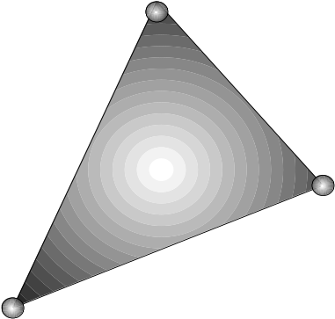
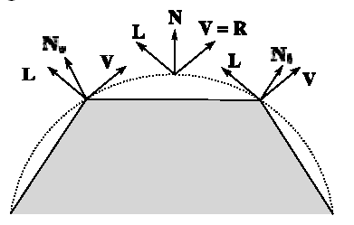
1. Goraud shading
Flaws of Gouraud Shading:
1) Highlight anomalies
If the highlight appears in the interior of the polygon, Gouraud
shading may fail to shade this highlight because no highlighted intensities are recorded/calculated at the vertices.
Simple solution: smaller polygons

Slide 8
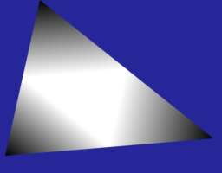
1. Goraud shading
Flaws of Gouraud Shading:
2) Banding
Human visual system is especially good at detecting edges. Abrupt changes in shading between 2 facets are perceived to be greater than they actually are. The bands can be obvious if insufficient polygons are used to model area of high curvature. Again, simple solution: smaller polygons

Slide 9
2. Phong shading
Instead of interpolating the vertex intensities, Phong interpolates vertex normal vector.
Solves the interior highlight problem:
Interpolation equations are:
N_{a} = [ N₁ (y_{s}- y₂ ) + N₂ (y₁-y_{s}) ] / (y₁ - y₂)
N_{b} = [ N₁ (y_{s}- y₃) + N₃ (y₁-y_{s}) ] / (y₁ - y₃)
N_{s} = [ N_{a} (x_{b}- x_{s}) + N_{b} (x_{s}-x_{a}) ] / (x_{b} - x_{a})

Slide 10
2. Phong shading
Notes:
Since illumination calculation has to be invoked at each interior surface point, Phong shading is more expensive than Gouraud shading.
Do not mix up Phong shading and Phong model (Phong llumination model). They are different things!

Slide 11
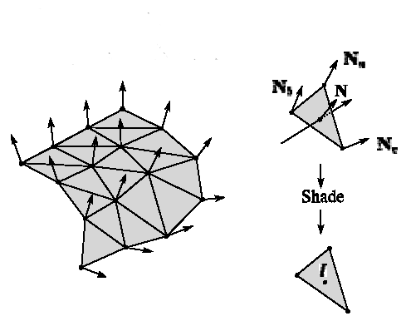
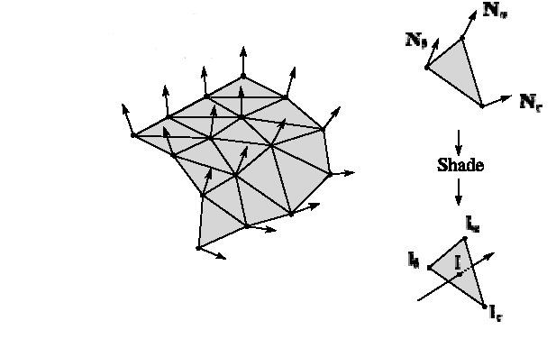
Goraud shading vs. Phong shading
Phong Shading
Compute vertex normals
Interpolate normals and normalize
Shade each pixel using the interpolated normals (using Phong equation)
Gouraud Shading
Compute vertex normals
Shade only vertices
(using Phong equation)
Interpolate the resulting vertex colors
Gouraud interpolation
Phong interpolation

Slide 12
Summary for Interpolative Shading
Here’s what you should take home from this lecture:
Gouraud shading
Phong shading
Their comparative advantages and disadvantages

Slide 13
Lighting in OGL
Light Source:
  Ambient Light source:
  glLightModelfv ( GL_LIGHT_MODEL_AMBIENT , …)
  (this is a global ambient term)
  Directional Light (see glLightfv)
  Point Light (see glLightfv)
  same as directional light source but with non-zero w in the homogeneous coordinate
  Spot Light (CUTOFF and EXPONENT terms)

Slide 14
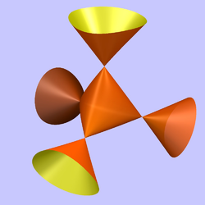
Lighting in OGL
Surface Property: Material
  Use glMaterial ( arg1 , arg2 , input values )
  arg1: GL_FRONT, GL_BACK, etc.
  arg2: GL_EMISSION, GL_AMBIENT, GL_DIFFUSE,
GL_SPECULAR, GL_SHINNESS, etc. (terms in Phong model)
  Input values: corresponding coefficients for RGBA
  (check Nate Robin’s lightmaterial.exe demo)
Two-sided lighting

Slide 15
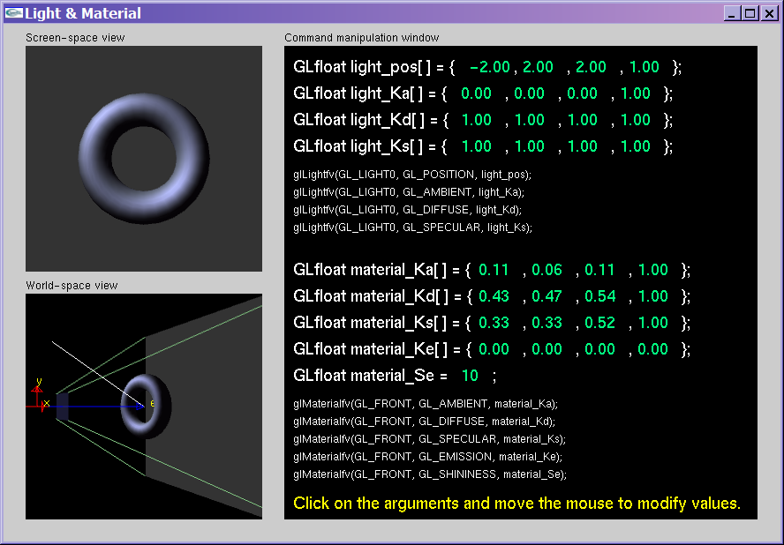
Nate Robin’s lightmaterial.exe

Slide 16
Lighting in OGL
Things to notice about OGL lighting
  Check the OGL Red book for the OGL illumination model; it is
  based on the Phong Illumination model
  glEnable ( GL_LIGHTING )
  OGL will use its illumination model (see Red book) to compute the vertex/face color, else it will pick up the color directly from glColor
  A good practice: Enable Lighting only when you need shading for
  your polygons because using glColor is much faster (or using
  texture to add surface details)
  OGL needs normals, call glNormal before your glVertex (one per
  face for face normal and one per vertex for vertex normal)
  Provide unit vector to OGL when calling glNormal

Slide 17
Lighting in OGL
Things to notice about OGL lighting
  If the normal you supplied to glNormal is not a unit vector OR
  if you have scaling/shearing in your modelview transformation, you will need to call glEnable ( GL_NORMALIZE ) so that OGL can help
  you to automatically unify the normals before doing the lighting calculation. Else, surfaces could be over/under-illuminated. But of course, this will slow down the rendering process a little bit.
  (Note on Red book appendix: we have to transform normals from world to eye space and lighting calculation is done in eye space)
  glShadeModel ( GL_SMOOTH ) -> Gourand shading
  glShadeModel ( GL_FLAT ) -> No interpolative shading

